Slide 1
Distillation – Training SLM using LLM rationales Candidate Project 2: LLM-SLM Application Group 5 Chia Dehan
Colin Jiang Kelin
Keith Wong Jincong
Lim Wei Jie
Quah Zong You

Slide 2
Contents
Task #1 Arithmetic Reasoning
Task #2
Code Generation
Introduction
Training SLM
Conclusion

Slide 3
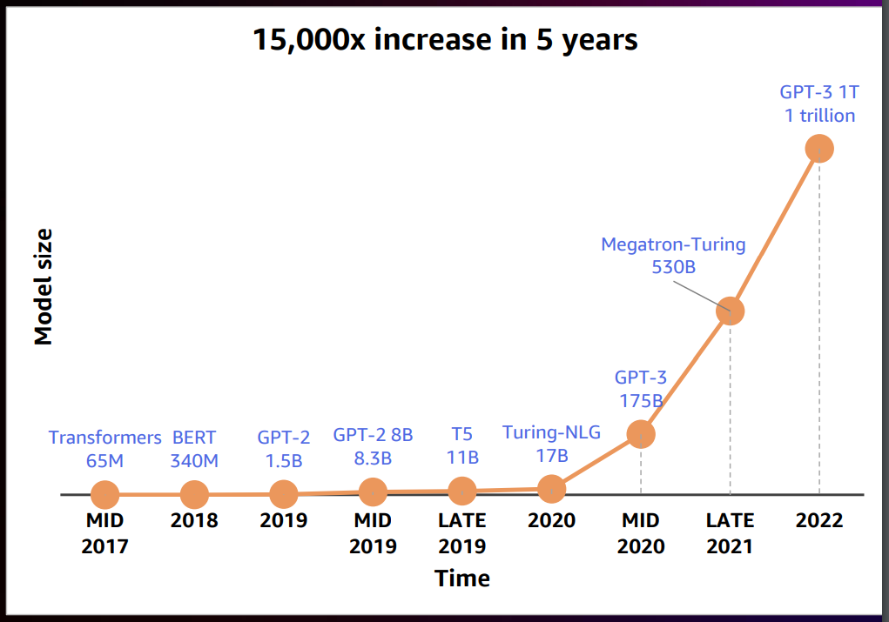
Model Sizes over the Years
Model Sizes have been increasing exponentially
Model size with 175 billion parameters require at least 350GB-worth of GPU to compute (Zheng et al., 2022)
Notes:
We can see that model sizes have been increasing, from having 65M parameters to over 1 trillion. A very interesting thing would be a paper actually estimated that a model with 175B parameters will require at least 350GB worth of GPU. Let’s take a more detailed look into the amount of compute needed.

Slide 4


How much compute needed
Assume it has a close architecture to GPT-3.5, it roughly has 175B parameters
To load the model and text: 5 x A100 Nvidia GPU (80 GB)
How much compute needed?
ChatGPT generates on average 15 to 20 tokens per second.
ChatGPT takes on average 350ms to generate a word.
To churn out words:
8 x A100 Nvidia GPU (80GB)
A 3B parameter model can generate 1 token on average in 6ms on an A100 GPU.
Notes:
Let’s take chatgpt as an example. Assuming chatgpt is close in architecture to gpt3.5, it should have 175B parameters. In order to load such a model and input text, we require 5 A100 Nvidia GPU. A 3B parameter model can generate 1 token on average every 6ms. This means it takes chatgpt 350ms to generate a word. Assuming chatgpt generate on average 15 to 20 tokens per second, it takes 8 A100 GPU to churn out the words.

Slide 5

Finops Costs Involved
OpenAI acquired 1M users within 5 days.
Assume each user gives ~10 queries / day
10M queries / day
On Azure Cloud: ~$3/hour
A100 Nvidia GPU (80GB)
Assuming each query returns a response of 30 words on average
Estimated cost:
~$100k / day
Averages out to be ~$0.0003 / word
~$0.01 / query
Notes:
Next, we look at the cost required. On azure cloud, to rent a A100 GPU, it is roughly $3/hour or $0.0003 per word. Assuming each query only returns 30 words, this amounts to 1 cent per query. Considering the fact that openAI acquired 1M users in the first 5 days and a user may generate 10 queries per day, this could result in a estimated cost of $100k/ day.

Slide 6
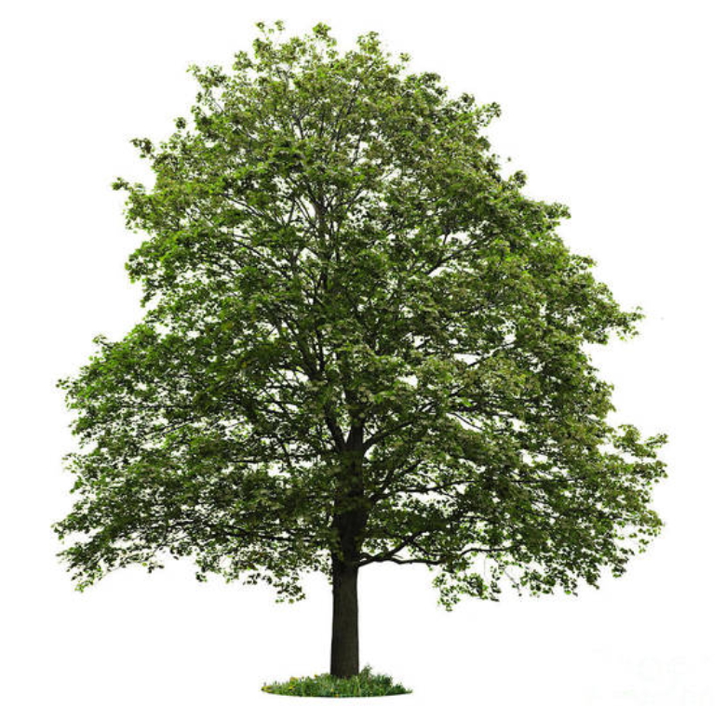
Environmental Costs Involved
To compensate 1 ton of CO2,
31 to 46 trees are needed.
Patterson et al. (2022)
Estimated that the original GPT-3 cost 502 tons of CO2 to train.
RLHF would add a bit of overhead on that, perhaps on the order of 1% of the original cost.
???
Notes:
On top the finops costs, it was estimated that the original GPT3 cost 502 tons of CO2 to train, and that in order to compensate 1 ton of CO2, 31 to 46 trees are required.

Slide 7
Environmental Costs Involved
To compensate 1 ton of CO2,
31 to 46 trees are needed.
Patterson et al. (2022)
Estimated that the original GPT-3 cost 502 tons of CO2 to train.
RLHF would add a bit of overhead on that, perhaps on the order of 1% of the original cost.
~20k
Notes:
This means that in order to remove the CO2 produced from the training of GPT3, we need to plant 20 thousand trees.

Slide 8
Why is Distillation important?
✘
✘
Financial Costs
Environmental Cost
~$100k / day to run inference for 10M queries / day
GPU utilization is never 100%, thus costs could be a lot higher.
Patterson et al. (2022) estimated that the original GPT-3 cost 502 tons of CO2 to train.
Explodes exponentially with user growth.
Notes:
Therefore, we can see that financially and environmentally, the costs are really high. And this could be higher as GPU utilization is never at 100% and user growth explodes.

Slide 9
Mitigative Measure 1 – Engineer Better Models
Gpt3.5 Turbo
1
Lower Cost
On March 1st, OpenAI switched to a new model for ChatGPT, gpt3.5-turbo.
This new model is 1/10th the cost of davinci to end users
2
Lower Carbon
Effects
3
And it is reasonable to assume that it has, consequently, 1/10th the carbon intensity.
Reduces Training cost
Reduces Inference cost
Reduces Carbon footprint
4
Notes:
Mitigative measures are required. The first measure would be a better model. For instance, we can see that openAI managed to engineer a better model in the form of gpt3.5 from gpt 3. This model uses 1/10th of the cost of davinci and subsequently 1/10th of the carbon intensity. This reduces training and inferences cost as well as the carbon footprint.

Slide 10
Mitigative Measure 2 – Compress Model Sizes
Decrease Model Size while retaining performance
1
Effects
Reduces inference cost substantially
Reduces data storage costs
SLMs performs substantially better than LLMs
2
Example:
Distil LLMs into smaller task specific models using considerably less data.
Especially useful in cases whereby companies only use LLMs for a specific downstream task, such as Financial Statement summarization.
Notes:
A second mitigative measure would be compressing model sizes while retaining performance. This is because most targeted users usually have a specific preference of what they can use the models for, hence in essence, they do not to continuously utilize the LLMs for inference.

Slide 11
Project goals
General Goals
Notable Constraints
Recompose this problem as:
Minimize compute resources
Retain or even improve on the performance of SLM over LLM
Solve more complex problems with the SLM, such as arithmetic reasoning
Self-sponsored using google colab credits and personal GPU
Spent ~1000 credits spent on tinkering with Flan-T5-Large, Flan-T5-small, T5-Small, T5-Base and vanilla transformers
Distil knowledge from medium-sized models to even smaller models.
Attempt to retain the performance of the medium-sized models
Solve more complex problems with the SLM, such as arithmetic reasoning
Notes:
The general goals of our project is to enable mitigative measure 2 by attempting to minimize compute while retaining performance of the SLM over LLM. However, instead of applying it on simpler tasks, we attempted to distil the abilities to do more complex tasks onto the SLMs. However, due to the constraints of our own personal compute resources, we aimed to recompose our project goals into distilling knowledge from medium sized models to even smaller models, with the hope of retaining the performance of the medium-sized models on arithmetic reasoning.

Slide 12
What is Distillation?
Large Transformer Model
Smaller Transformer Model
Predicted Labels
Teacher
Distil into
Student
Predicted Rationale
Fewer params
Faster inference
Similar or better performance than parents

Slide 13
Methodology Distillation Step by Step
Referenced from:
Distilling Step-by-Step! Outperforming Larger Language Models with Less Training Data and Smaller Model Sizes
The writers developed a Distillation method which is able to enable smaller models to out-perform Large Language models with less training data
The method is tried on multiple NLP tasks, such as natural language inference and commonsense question answering
“our 770M T5 model outperforms the 540B PaLM model using only 80% of available data on a benchmark task”

Slide 14
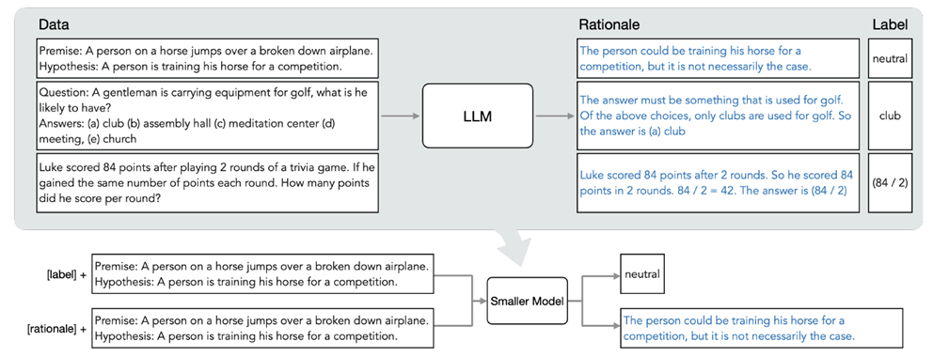
Methodology Distillation Step by Step
LLM
Step 1: Use LLM to generate Rationales

Slide 15
Methodology Distillation Step by Step
SLM
Step 2a: Prepend special token [label] to questions for predicting labels
Step 2b: Prepend special token [rationale] to questions for predicting rationales
Step 3: Train SLM

Slide 16
Methodology Distillation Step by Step
Use best prompt method to generate output from training set
SLM Inference and Evaluation on test set
01
02
03
04
05
Generate Labels and Rationales using LLM through Prompts
Use generated rationales and labels to train SLMs
Which Prompt method?
Conduct experiment on test set

Slide 17
Teacher-Student Models
Teacher
Student
(Flan) T5 models
T5 models that are pretrained on many datasets including gsm8k
(Flan) Finetuned with instructions
Ideally, we want a larger teacher model. However due to hardware limitations, we are unable to go beyond the Large version.
780m
80m
60.5m
4.7m
Flan-T5-Large
Flan-T5-Small
T5-Small
Vanilla Transformer
3.13gb
storage size

Slide 18
Task #1: Arithmetic Reasoning
Data Set
gsm8k
{"question": “A robe takes 2 bolts of blue fiber and half that much white fiber. How many bolts in total does it take?”,
"full_answer": “It takes 2/2=<<2/2=1>>1 bolt of white fiber\nSo the total amount of fabric is 2+1=<<2+1=3>>3 bolts of fabric\n#### 3”}
7473 Train 1319 Test Curated Answers with Step-by-step explanations

Slide 19
Task #1: Arithmetic Reasoning
Prompts
Zero-shot CoT
Few-shot (k=4) CoT
Progressive Hint Prompter (PHP)
Question: Joy can read 8 pages of a book in 20 minutes. How many hours will it take her to read 120 pages?
Answer: Let’s think step by step.
Question: Olivia has $23. She bought five bagels for $3 each. How much money does she have left?
Answer: Let’s think step by step. Olivia had 23 dollars. 5 bagels for 3 dollars each will be 5 x 3 = 15 dollars. So she has 23 - 15 dollars left. 23 - 15 is 8. The answer is 8.
Question: Joy can read 8 pages of a book in 20 minutes. How many hours will it take her to read 120 pages?
Answer: Let’s think step by step.
Question: Olivia has $23. She bought five bagels for $3 each. How much money does she have left?
Answer: Let’s think step by step. Olivia had 23 dollars. 5 bagels for 3 dollars each will be 5 x 3 = 15 dollars. So she has 23 - 15 dollars left. 23 - 15 is 8. The answer is 8.
Question: Joy can read 8 pages of a book in 20 minutes. How many hours will it take her to read 120 pages?
Answer: Let’s think step by step.
(Hint: The answer is near to [previous answer])

Slide 20
Task #1: Arithmetic Reasoning
LLM’s Inference
Question:
Janet's ducks lay 16 eggs per day. She eats three for breakfast every morning and bakes muffins for her friends every day with four. She sells the remainder at the farmers' market daily for $2 per fresh duck egg. How much in dollars does she make every day at the farmers' market?"
Zero-shot CoT
Few-shot (k=4) CoT
Progressive Hint Prompter (PHP)
Answer: <pad> Janet eats 3 eggs for breakfast and 4 for muffins every day for a total of 3 + 4 = 7 eggs. She sells the remaining 16 eggs at the farmers' market for $2 per egg for a total of 16 - 7 = $8 per day. The answer: 8.</s>
Answer: <pad> Janet eats 3 eggs for breakfast every morning for a total of 3 * 16 = 48 eggs. She bakes 4 muffins for her friends every day for a total of 4 * 4 = 16 muffins. She has 16 - 48 - 16 = 8 fresh duck eggs left. She sells 8 - 4 = 4 fresh duck eggs at the farmers' market every day for $2 per egg. She makes $2 * 4 = $8 per day at the farmers' market. The answer is 8.</s>
Answer: <pad> Janet eats 3 + 4 = 6 eggs a day. So she has 16 - 6 = 8 eggs left. She sells the remaining 8 eggs for $2 per egg, so she makes 8 * 2 = $8 per day. The answer is 8.</s>

Slide 21
Task #1: Arithmetic Reasoning
Prompt Experiment
Test dataset 1319 Questions Model: Flan-T5-Large
 | Accuracy (%) | Inference time (mins)
Zero-shot CoT | 5.76 | 67
Few-shot (k=4) CoT | 6.74 | 55
Progressive Hint Prompter | 7.35 | 155
Although PHP gave the best accuracy, the rationales generated deteriorated
We chose to proceed with Few-shot (k=4) CoT as it has the best accuracy and rationales

Slide 22
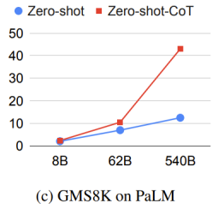
Task #1: Arithmetic Reasoning
Prompt Experiment
Test dataset 1319 Questions Model: Flan-T5-Large
Remember this?
(Session 9
Advanced_tech
Slide 42)
 | Accuracy (%) | Inference time (mins)
Zero-shot CoT | 5.76 | 67
Few-shot (k=4) CoT | 6.74 | 55
Progressive Hint Prompter | 7.35 | 155
Although PHP gave the best accuracy, the rationales generated deteriorated
We chose to proceed with Few-shot (k=4) CoT as it has the best accuracy and rationales

Slide 23
Task #1: Arithmetic Reasoning
Prompt Experiment
Although PHP gave the best accuracy, the rationales generated deteriorated.
Rationales became incoherent and start quoting the “Hints” provided.
"rationale": "<pad> Sandra has to babysit their daughter 9 / 3 = 2 times. So she has to babysit for 2 * 15 = 30 times. The answer is near to 5.</s>"
"rationale": "<pad> Bailey receives a weekly allowance of $5 for 8 weeks, so she receives a total of 8 * $5 = $40 for the 8 weeks. The total amount of money she has at the end of the 8 weeks is $100 - $40 = $60. The amount of money she started with is 60 / 8 = $5. The answer is near to 60.</s>"

Slide 24
Task #1: Overall Approach
S/N | Model | Remarks | # Parameters
1 | T5-small | Addition of [label] and [rationale] | 60M
2 | Transformer | Addition of [label] and [rationale] | 4.7M
3 | FLAN-T5-small | Addition of ‘Generate labels and rationale for:’ | 80M
Notes:
For our overall approach when tackling the task of arithmetic reasoning, we attempted to train 3 models.
The first two is T5-small and a transformer with 3 layers and 8 multi-headed attention nodes, where we tried to follow the approach taken in the original paper as much as possible through the additional of special tokens to tokenizer.
And the third model we tried a variation of the paper’s prompting through the addition of ‘Generate labels and rationale for:’. In terms of parameters comparatively less than the models used in the paper.

Slide 25

Training SLM 1 - T5-small
Patience = 5
8 gradient accumulation steps of batch-size 8 for an effective size of 64
512 max input token length
Addition of [label] and [rationale] special tokens into tokenizer and as prefixes onto model inputs
Addition of lambda regularization into the loss function.
Ran on Google Colab A100 GPU (40GB)
T5 models
T5 models that are pretrained a different set of datasets to FLAN-T5
Finetuned with instructions
Notes:
Trained til validation stabilises, with a patience of 5.
Effective batch size of 64.
512 max input token length.
And in moving towards the multitask objective we add label and rationale special tokens, along with lambda regularization between the tasks’ losses. Lambda is used to increase the weightage of the losses of the rationale task in contribution to the overall loss

Slide 26
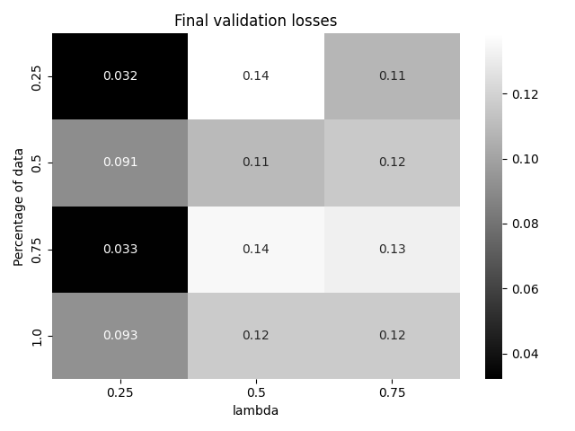
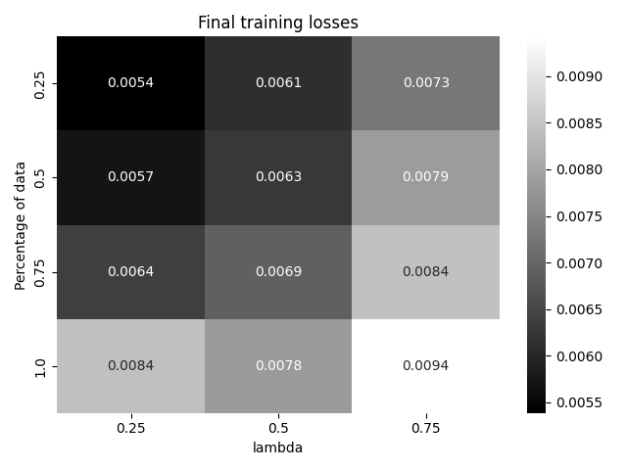
Training SLM 1 – T5-small
Notes:
For this experiment we trained 12 models, 3 lambda on the x multiplied by 4 percentages of data used on the y axis.
Looking at val losses on the left, we observe that a higher lambda generally results in a higher final val loss and training losses.

Slide 27
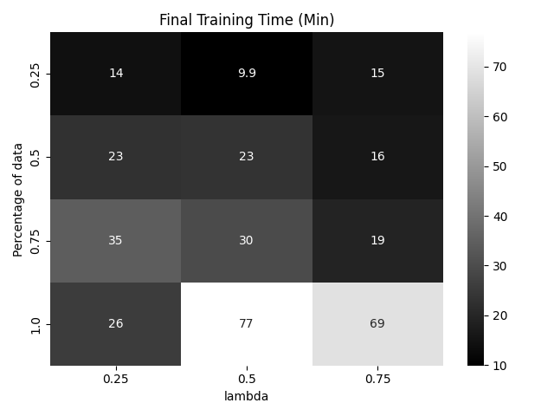
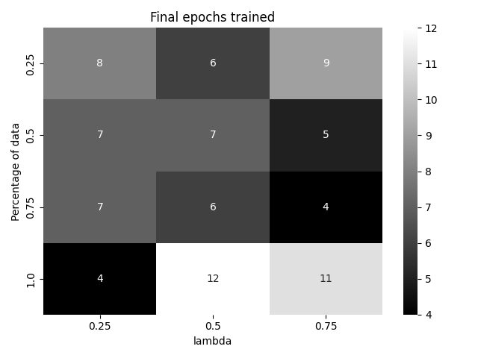
Training SLM 1 – T5-small
Notes:
For training time, we see that an increase of training data will take a longer training time and more final epochs trained.
For lambda we observe that no clear trends here.

Slide 28
SLM 1 - T5-small example
Task | Question | Generated answer
[Label] | Natalia sold clips to 48 of her friends in April, and then she sold half as many clips in May. How many clips did Natalia sell altogether in April and May? | ‘Natalia sold clips to 48 of her friends in April, so she sold clips to 48 of her friends in April, so she sold clips to 48 of her friends in April, so she sold clips to 48 of her friends in April, so she sold clips to 48 of her friends in April, so she sold clips to 48 of her friends in April, so she sold clips to 48 of her friends in April, so she sold clips to 48 of her friends in April, so she sold clips to 48 of her friends in April, so she sold clips to’
[Rationale]
Notes:
We see one example here of the model’s prediction. So we se the question in the middle. In this case no matter if we passed in label or rationale special tokens, we still got the same generated answer, which seems to be repeating a subsection of the question. So in this case it’s admittedly not very useful, but it’s just our first experiment. So let’s see how the transformer performed.l

Slide 29
Training SLM 2 – Vanilla Transformer
Pytorch implementation
Trained on generated rationales and labels
Batch size of 4
Similar to SLM1, prepend special tokens [label] and [rationale]
Transformer(
num_tokens=20000,
dim_model=128,
num_heads=8,
num_encoder_layers=3,
num_decoder_layers=3,
dropout_p=0.2
)

Slide 30
Training SLM 2 – Vanilla Transformer
% Training Data* | Training loss | Validation loss | Learning rate | Epochs trained | Training time | Inference time
100 | 0.8750 | 0.8820 | 0.1 | 10 | 39 mins 31 sec | 24 sec
100 | 0.7191 | 0.7883 | 0.1 | 20 | 78 mins 8 sec | 24 sec
100 | 0.6244 | 0.7543 | 0.1 | 30 | 116 mins 50 sec | 24 sec
100 | 0.5613 | 0.7352 | 0.01 | 40 | 155 mins 25 sec | 24 sec
100 | 0.5506 | 0.7333 | 0.01 | 50 | 195 mins 23 sec | 24 sec
% Training Data refers to the % of LLM-Generated Rationale & Labels
The above test are run on RTX3070 (8GB)

Slide 31
Training SLM 2 – Vanilla Transformer
Learning Rate decay 0.1 -> 0.01
Training and Validation loss continues to improve
But…

Slide 32
Training SLM 2 – Vanilla Transformer
% Training Data* | Epochs trained | Accuracy
100 | 10 | 0.38%
100 | 20 | 1.59%
100 | 30 | 0.68%
100 | 40 | 0.45%
100 | 50 | 0.53%
% Training Data refers to the % of LLM-Generated Rationale & Labels

Slide 33
Training SLM 2 – Vanilla Transformer
Transformer was able to learn the special tokens and give correct output.
But not all the time. We suspect that more epochs and data is required.
"question": "<label> <cls> Bob had 7 fish in his ornamental fish pond. 3 were orange, and 4 were white. He decided he wanted to …"
"answer": "4"
"question": "<rationale> <cls> Bob had 7 fish in his ornamental fish pond. 3 were orange, and 4 were white. He decided he wanted to …"
"answer": "he caught 2 * 2 = 4 fish …"

Slide 34
Training SLM 3 - FLAN-T5-small
Patience = 5, early stopping when validation loss stabilises
16 gradient accumulation steps of batch-size 4 for an effective size of 16
512 max input token length
Addition of ‘Generate rationale and labels:’ into tokenizer and as prefixes onto model inputs
Notes:
We used Flan t5 small as our third SLM for comparison. The training process is the same as the first SLM, but with the difference in the prefixed tokens “Generate rationale and labels”.

Slide 35
Training SLM 3 – FLAN-T5-small
% Training Data* | Training loss | Validation loss | Epochs trained | Training time | Inference time
25 | 1.1751 | 0.844922 | 7 | 5 mins 22 sec | 90.3 min
50 | 1.1107 | 0.849214 | 7 | 10 min 56 sec | 90.5 mins
75 | 1.0847 | 0.832630 | 7 | 16 mins 57 sec | 90.9 mins
100 | 0.9323 | 0.746988 | 7 | 23 mins 32 sec | 90.7 mins
% Training Data refers to the % of LLM-Generated Rationale & Labels
The above tests are run on Google Colab T4 GPU (15 GB)
Notes:
We then train the SLM on 4 slices of the training data generated by the LLM. As you can see the training loss and validation loss decreases with more data whilst the training time increases. The inference time remains approx. the same, as the model size does not increase.
Training time taken for Finetuned on original ground truth takes: 23 mins 58 seconds
Inference time for Finetuned on original ground truth takes:

Slide 36
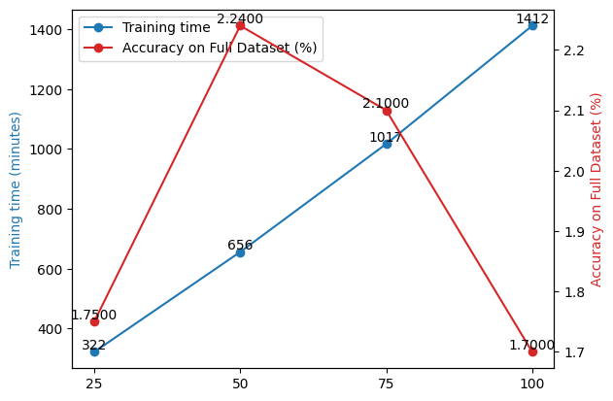
Results of Trained SLM 3 – FLAN-T5-small
% Training Data* | Accuracy
25 | 1.753%
50 | 2.235%
75 | 2.101%
100 | 1.700%
Results (Distilled)
Variants | Accuracy
Zero-shot | 1.900%
Finetuned on Ground-truth rationale & labels | 1.786%
Benchmarks
To get a benchmark comparison of our distilled SLM:
Reran a zero-shot version of the original SLM on the full dataset.
Finetuned SLM on the original ground truth labels and explanation from the dataset to see if the LLM did teach the SLM better.
% Training Data refers to the % of LLM-Generated Rationale & Labels
Notes:
Next, we compute the trained models on the dataset to get the accuracy. In the graph on the right, we can see that whilst training the model, we can see that training time actually increases linearly whereas there is a dropoff in the accuracy of the As you can see, the model does very badly, but there are instances where our distilled models exceeds the 2 benchmarks below. Interestingly, we find that the SLM finetuned on ground-truth rationale and labels performs worse than the zero-shot. There could be several possible reasons:
Not enough epochs
Max input token length too short, the ground-truth rationales are pretty long
data size to finetune over is smaller than the original paper (8k vs a few 100k)
Task harder also

Slide 37
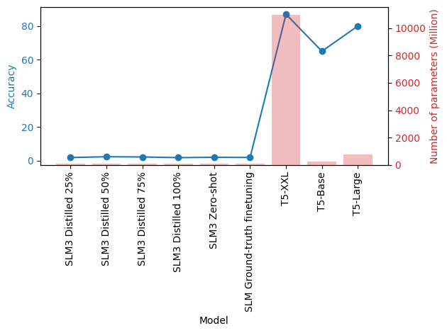
Results of Trained SLM 3 – FLAN-T5-small
% Training Data* | Accuracy
25 | 1.753%
50 | 2.235%
75 | 2.101%
100 | 1.700%
% Training Data refers to the % of LLM-Generated Rationale & Labels
Variants | Accuracy
Zero-shot | 1.900%
Finetuned on Ground-truth rationale & labels | 1.786%
To get a benchmark comparison of our distilled SLM:
Reran a zero-shot version of the original SLM on the full dataset.
Finetuned SLM on the original ground truth labels and explanation from the dataset to see if the LLM did teach the SLM better.
Notes:
Now, in the graph, we compare our SLMs with T5-XXL, T5-Base and T5-Large. We can see that indeed there is a large performance difference. We note this to the size of the SLM we are using as well as the size of the LLM we used to extract the rationales.

Slide 38
Efficiency of models
Method | Model | Accuracy | Number of parameters (Million) | % of XXL accuracy | % of XXL params
Distilling | SLM3 Distilled 25% | 1.75% | 80 | 2.01% | 0.73%
Distilling | SLM3 Distilled 50% | 2.24% | 80 | 2.57% | 0.73%
Distilling | SLM3 Distilled 75% | 2.10% | 80 | 2.41% | 0.73%
Distilling | SLM3 Distilled 100% | 1.70% | 80 | 1.95% | 0.73%
Zero-shot | SLM3 Zero-shot | 1.90% | 80 | 2.18% | 0.73%
Standard finetuning | SLM Ground-truth finetuning | 1.79% | 80 | 2.05% | 0.73%
Distilling (paper) | T5-XXL | 87% | 11000
Notes:
To have a more detailed look of the models, we can see that our model is 138 times smaller than the distilled T5-XXL used in the original paper, but again, severely underperforms the paper’s results. There could be several possible reasons:
Not enough epochs
Max input token length too short, the ground-truth rationales are pretty long
data size to finetune over is smaller than the original paper (8k vs a few 100k)
Task harder also

Slide 39
Training SLMs – Future work
Category | Description
Lambda Tuning | Reduced weightage of rationale vs label task losses
Parameter Tuning | Percentage of dataset to be used for training
Increased epochs | Student model may not be learning the special tokens with too few epochs
Increased maximum token size | 512 to 1024, the input rationales into the student model generally seem to be longer than 512.
Answer Verifier | Correction of Arithmetic operations in generated rationales

Slide 40
Answer Verifier
Possible Future work.
A function that automatically corrects the math in generated rationales, potentially improving quality of generated rationales
Answer: <pad> Janet eats 3 + 4 = 6 eggs a day. So she has 16 - 6 = 8 eggs left. She sells the remaining 8 eggs for $2 per egg, so she makes 8 * 2 = $8 per day. The answer is 8.</s>
In-place correction
Answer: <pad> Janet eats 3 + 4 = 7 eggs a day. So she has 16 - 6 = 10 eggs left. She sells the remaining 8 eggs for $2 per egg, so she makes 8 * 2 = $16 per day. The answer is 8.</s>
Achieved
Sequential correction
Answer: <pad> Janet eats 3 + 4 = 7 eggs a day. So she has 16 - 7 = 9 eggs left. She sells the remaining 9 eggs for $2 per egg, so she makes 9 * 2 = $18 per day. The answer is 18.</s>
Very Difficult
True label = 18

Slide 41
Task #2: Code Generation
phase (int32) | question (string) | table (dict) | sql (dict)
1 | "Name the background colour for the Australian Capital Territory" | { "header": [ "State/territory", "Text/background colour", "Format", "Current slogan", "Current series", "Notes" ], "page_title": "", "page_id": "", "types": [ "text", "text", "text", "text", "text", "text" ], "id": "1-1000181-1", "section_title": "", "caption": "", "rows": [ [ "Australian Capital Territory", "blue/white", "Yaa·nna", "ACT · CELEBRATION OF A CENTURY 2013", "YIL·00A", "Slogan screenprinted on plate" ], [ "New South Wales", "black/yellow", "aa·nn·aa", "NEW SOUTH WALES", "BX·99·HI", "No slogan on current series" ], [ "New South Wales", "black/white", "aaa·nna", "NSW", "CPX·12A", "Optional white slimline series" ], [ "Northern Territory", "ochre/white", "Ca·nn·aa", "NT · OUTBACK AUSTRALIA", "CB·06·ZZ", "New series began in June 2011" ], [ "Queensland", "maroon/white", "nnn·aaa", "QUEENSLAND · SUNSHINE STATE", "999·TLG", "Slogan embossed on plate" ], [ "South Australia", "black/white", "Snnn·aaa", "SOUTH AUSTRALIA", "S000·AZD", "No slogan on current series" ], [ "Victoria", "blue/white", "aaa·nnn", "VICTORIA - THE PLACE TO BE", "ZZZ·562", "Current series will be exhausted this year" ] ], "name": "table_1000181_1" } | { "human_readable": "SELECT Text/background colour FROM table WHERE State/territory = Australian Capital Territory", "sel": 1, "agg": 0, "conds": { "column_index": [ 0 ], "operator_index": [ 0 ], "condition": [ "Australian Capital Territory" ] } }
Dataset: WikiSQL
Dataset summary: WikiSQL is a large crowd-sourced dataset with hand-annotated examples of questions and SQL queries from Wikipedia.
Sample data (simplified):
Question
Table Headers
SQL
Name the background colour for the Australian Capital Territory
State/territory
Text/background colour
Format
Current slogan
Current series
Notes
SELECT Text/background colour
FROM table
WHERE State/territory = Australian Capital Territory

Slide 42
Task #2: Code Generation
Our aim: Train SLM with rationales generated by LLM for code generation task.
Example:
Large Transformer Model
SELECT clause: Specify the columns we want to retrieve. In this case, we want to retrieve the background colour.
FROM clause: Specify the table we are querying from.
WHERE clause: Specify the condition that the rows must meet in order to be included in the result. In this case, we want to retrieve the background color for the Australian Capital Territory.
By combining these clauses, the SQL query selects the background_colour from the table where the region_name is 'Australian Capital Territory'.
Teacher

Slide 43
Task #2: Code Generation - Prompts
Zero-shot
Zero-shot CoT
"Split-SQL"
(adapted from Divide and Prompt approach)
Translate English to SQL: Name the background colour for the Australian Capital Territory.
Translate English to SQL:
Name the background colour for the Australian Capital Territory.
A: Let's think step by step.
In SQL, what column do I have to SELECT to solve:
Name the background colour for the Australian Capital Territory.
In SQL, what WHERE condition do I have to set to solve:
Name the background colour for the Australian Capital Territory.
Other prompts experimented include providing the table headers, and the Divide and Prompt approach in 'Divide and Prompt: Chain of Thought Prompting for Text-to-SQL' by Liu and Tan (2023).

Slide 44
Task #2: Code Generation
Prompt Experiment – Results from 1500 questions in Test Dataset
 | Flan-T5-Large |  | T5-base-finetuned-wikiSQL
 | Accuracy (%) | Similarity Score | Accuracy (%) | Similarity Score
Zero-shot | 0.0 | 0.332 | 44.5 | 0.901
Zero-shot CoT | 0.0 | 0.355 | 44.3 | 0.897
"Split-SQL" | 0.0 | 0.416 | 0.0 | 0.364
Similarity score was also used as evaluation metric to avoid penalising models which provide meaningful but inaccurate SQL code e.g. wrong column name.
Unsurprisingly, results indicated the finetuned model performs better.
But we faced one big issue – the models were unable to provide any rationale!

Slide 45
Task #2: Code Generation - LLM Inference
LLM’s Inference
Question:
What is terrence ross' nationality
Zero-shot
Zero-shot CoT
"Split-SQL"
<pad> SELECT Nationality FROM table WHERE Player = Terrence Ross</s>
<pad> SELECT Nationality FROM table WHERE Player = Terrence Ross</s>
SELECT <extra_id_0> FROM table WHERE Nationality = terrence ross FROM table WHERE <extra_id_0> WHERE condition = where?
Model: T5-base-finetuned-wikiSQL​

Slide 46
Task #2: Code Generation
Based on the results from the generated LLM Labels, we could not produce a rationale label hence we needed to find another way to justify the accuracy of our results
We stopped here and decided against training in the SLM for this task due to lack of rationale
Example text generated by LLM
Instead, we adopted another way to measure text similarity using the Levenshtein distance or edit distance.
This measures the minimum number of single-character edits (insertions, deletions, or substitutions) required to transform one string into another, in our case the similarity between the predicted answer and True SQL
Notes:
Since we are working with string data, such as SQL statements, we perform a string-level comparison to evaluate the accuracy. In this case, we use other string comparison methods or metrics to measure the similarity between the true and predicted SQL statement

Slide 47
Reasonings
✔
What we wish to achieve is rationales specific to code generation for SQL
✘
Issue : Our model adopted may not be suitable for SQL context, ChatGPT might be a better option (Generalisation)
✔
We applied the same principals of 2 different tasks using 1 methodology, distillation
✘
Issue: ‘Teacher’ is unable to give good pointers to the student for improvement of results
✔
Why the results are so different between SQL, Python or other languages
✘
Issue: Each available LLM is tuned, trained on different datasets meant for only 1 task, hard to find a common metric across all

Slide 48
Future Work/Improvements
Task: End Goal
01
Clear defined metrics for each task, is curation needed
Distillation
02
LLM Selection
Pretrained LLM using correct dataset and tasks, size of parameters available
03
Result Generation
Methodology used, zero shot, few shot, model parameters

Slide 49
Thank You!

